Slide 1

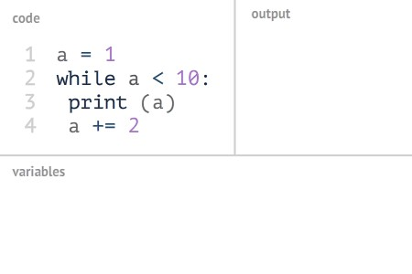

Slide 2
Object-Oriented Programming System (OOPs)
It is a methodology or paradigm to design a program using classes and objects.
It simplifies software concepts:
Class
Object
Method
Inheritance
Polymorphism
Abstraction
Encapsulation
development and maintenance by providing some

Slide 3
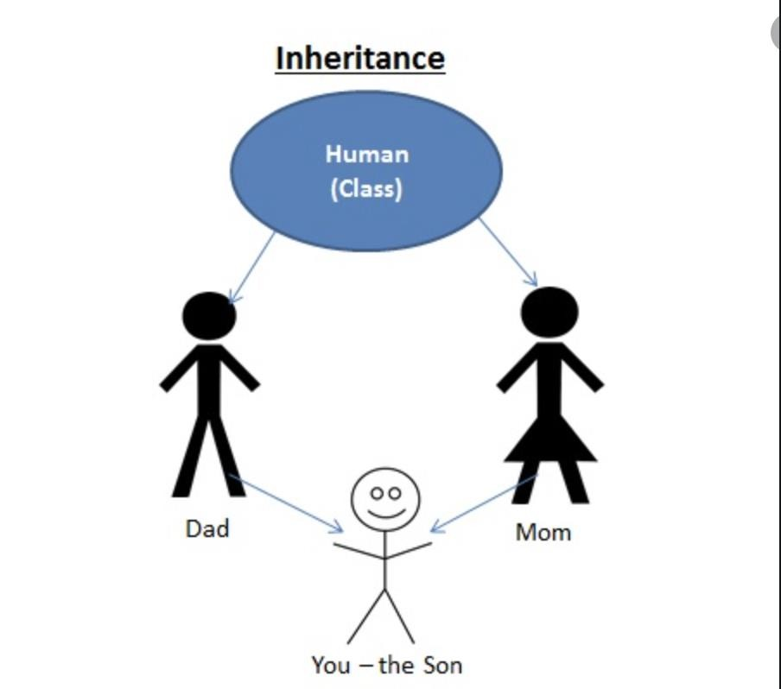
Inheritance
When one object acquires all the properties and behaviors of a parent object, it is known as inheritance.
It provides code reusability. It is used to achieve runtime polymorphism

Slide 4
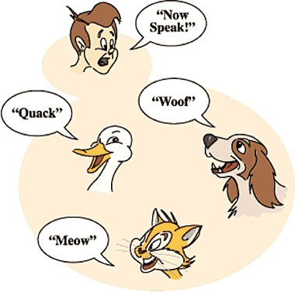
Polymorphism
if one task is performed in different ways, it is known as polymorphism.
For example: to convince the customer differently, to draw something,
For example, shape, triangle, rectangle, etc.

Slide 5


Abstraction
Hiding internal details and showing functionality is known as abstraction.
For Example: phone call, we don't know the internal processing.
Encapsulation
Binding (or wrapping) code and data together into a single unit are known as encapsulation.
For example, a capsule, it is wrapped with different medicines.

Slide 6
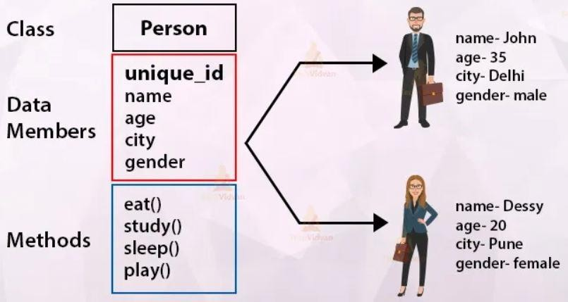
What is a Class?
The class can be defined as a collection of objects.
It is a logical entity that has some specific attributes and methods
A class can also be defined as a blueprint from which you can create an individual object.
Class doesn't consume any space.

Slide 7
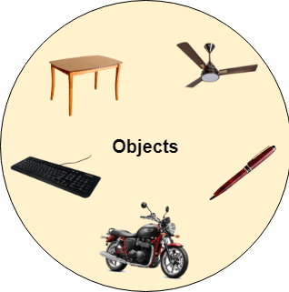
What Is an Object?
An Object can be defined as an instance of a class.
Any entity that has state and behavior is known as an object.
It can be physical or logical.
Example: A dog is an object because it has states like color, name, breed, etc. as well as behaviors like wagging the tail, barking, eating, etc.

Slide 8
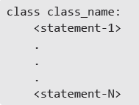
Classes and Objects
Classes and objects are the two main aspects of object oriented programming. In fact, a class is the basic building block in Python.
A class creates a new type and object is an instance (or variable) of the class. Classes provides a blueprint or a template
using which objects are created.
In fact, in Python, everything is an object or an instance of some class. For example, all integer variables that we define in our program are actually instances of class int. Similarly, all string variables are objects of class string. Recall that we had used string methods using the variable name followed by the dot operator and the method name. We have already studied that we can find out the type of any object using the type() function.

Slide 9



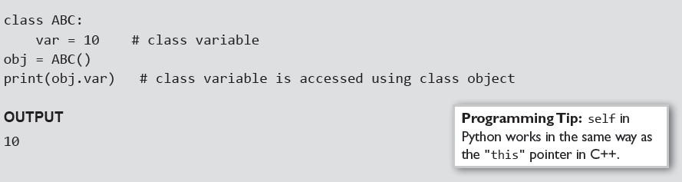
Creating Objects
Once a class is defined, the next job is to create an object (or instance) of that class. The object can then access class variables and class methods using the dot operator (.). The syntax to create an object is given as,
Creating an object or instance of a class is known as class instantiation. From the syntax, we can see that class instantiation uses function notation. Using the syntax, an empty object of a class is created. Thus, we see that
in Python, to create a new object, call a class as if it were a function. The syntax for accessing a class member through the class
object is
Example:

Slide 10
What is a Class in python?
Every element in a Python program is an object of a class.
A number, string, list, dictionary, etc., used in a program is an object of a corresponding built-in class.
>>> num=20
>>> type(num)
<class 'int’>
>>> s="Python"
>>> type(s)
<class 'str'>

Slide 11
Defining a Class
A class in Python can be defined using the class keyword.
class <ClassName>:
<statement1>
<statement2>
. .
<statementN>
Followed by the class name and : operator after the class name, which allows you to continue in the next indented line to define class members

Slide 12
Class members
1.Class Attributes 2.Constructor 3.Instance Attributes 4.Properties
5.Class Methods

Slide 13
A class can also be defined without any members
Defines an empty class using pass keyword
class Student: pass
the pass keyword is used to execute nothing;
It means, when we don't want to execute code, the pass can be used to execute empty

Slide 14
Class Variables And Object Variables
Basically, these variables are of two types- class variables.
variables and object
Class variables are owned by the class
object variables are owned by each object.

Slide 15
Class Variables And Object Variables
What this specifically means can be understood using following points.
If a class has n objects, then there will be n separate copies of the object variable as each object will have its own object variable.
The object variable is not shared between objects.
A change made to the object variable by one object will not be reflected in other objects.

Slide 16
Class Variables And Object Variables
If a class has one class variable, then there will be one copy only for that variable. All the objects of that class will share the class variable.
Since there exists a single copy of the class variable, any change made to the class variable by an object will be reflected to all other objects.

Slide 17
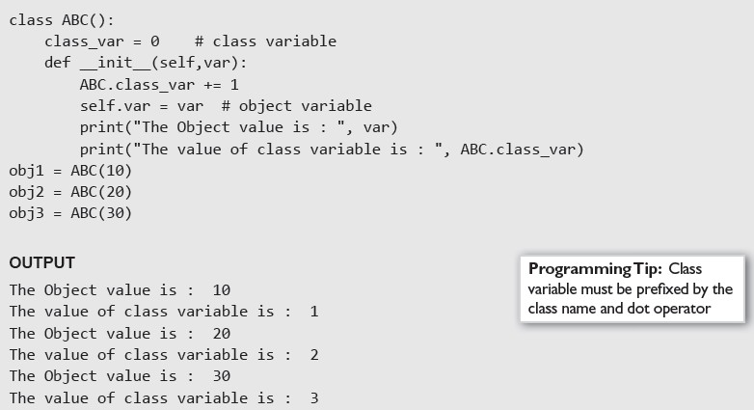
Class Variables And Object Variables - Example

Slide 18
Class Attributes/Variables
Class attributes are the variables defined directly in the class that are shared by all objects of the class.
Class attributes can be accessed using the class name as well as using the
objects.
Example: Define Python calss class Student:
CollegeName = ‘Dhanekula’
CollegeName is a class attribute defined inside a class.
The value of the CollegeName will remain the same for all the objects unless modified explicitly

Slide 19
How is class attribute accessed?
Example: Define Python calss
class Student:
CollegeName = ‘Dhanekula’
>>> Student. CollegeName
‘Dhanekula’
>>> std = Student()
>>> std. CollegeName
‘Dhanekula’
A class attribute is accessed by Student. CollegeName and std. CollegeName

Slide 20
Changing the value of class attribute
Changing the value of class attribute using the class name would change it across all instances.
However, changing class attribute value using instance will not reflect to other instances or class
class name: x=10
std=name()
std.x=20 print(std.x) print(name.x)

Slide 21
Constructor
The constructor in Python is used to define the attributes of an instance and assign values to them
In Python, the constructor method is invoked automatically whenever a new object of a class is instantiated, same as constructors in C# or Java.
The constructor must have a special name init () and a special parameter called self
The first parameter of each method in a class must be the self, which refers to the calling object or current object
However, you can give any name to the first parameter, not necessarily self
The init() method arguments are optional. We can define a constructor with any number of arguments

Slide 22
Constructor
class Student:
def init (self):
# constructor method
print('Constructor invoked’)
Std=Student()
whenever you create an object of the Student class, the init () constructor method will be called

Slide 23
self variable
It is not a reserved keyword.
it’s the best practice and convention to use the variable name as “self” to refer
to the instance.
class Dog:
def init (self, breed):
self.breed = breed
def bark(self):
print(f'{self.breed} is barking.’)
d = Dog('Labrador’)
d.bark()

Slide 24
Class with No Constructor
We can create a class without any constructor definition.
In this case, the superclass constructor is called to initialize the instance of the class.
The object class is the base of all the classes in Python
class Data: pass
d = Data() print(type(d))

Slide 25
Constructor with No-Arguments
We can create a constructor without any arguments
class Data1: count = 0
def init (self):
print('Data1 Constructor’)
Data1.count += 1
d1 = Data1() d2 = Data1()
print("Data1 Object Count =", Data1.count)

Slide 26
Class Constructor with Arguments
class Data2:
def init (self, i, n):
print('Data2 Constructor’)
self.id = i self.name = n
d2 = Data2(10, 'Secret’)
print(f'Data ID is {d2.id} and Name is {d2.name}')

Slide 27
Instance Attributes
Instance attributes are attributes or properties attached to an instance of a class. Instance attributes are defined in the constructor
class Student:
CollegeName = ‘Dhanekula’ #class attribute
def init (self): # constructor
self.name = ‘CSE’ # instance attribute
self.age = 11 # instance attribute
Std=student() Std.name Std.age
An instance attribute can be accessed using dot notation:
[instance name].[attribute name]

Slide 28
Values of Instance Attributes
class Student:
def init (self, name, age): self.name = name
self.age = age
std=Student('xyz',25) std.name

Slide 29
Class Properties
The property() function is used to define propeer
The property() method in Python provides an interface to instance attributes.
It encapsulates instance attributes and provides a property, same as Java and C#.
The property() method takes the get, set and delete methods as arguments and returns an object of the property class.
property(fget, fset, fdel, doc)
Parameters:
1.fget: (Optional) Function for getting the attribute value. Default value is none. 2.fset: (Optional) Function for setting the attribute value. Default value is none. 3.fdel: (Optional) Function for deleting the attribute value. Default value is none. 4.doc: (Optional) A string that contains the documentation. Default value is none.

Slide 30
Class Properties
class Student:
def init (self): self. name=''
def setname(self, name): print('setname() called') self. name=name
def getname(self):
print('getname() called') return self. name
def delname(self): print('delname() called') del self. name
name=property(getname, setname,delname)

Slide 31
Public, Private, and Protected Members
Public members (generally methods declared in a class) are accessible from outside the class.
The object of the same class is required to invoke a public method.
Protected members of a class are accessible from within the class and are also available to its sub-classes.
No other environment is permitted access to it. This enables specific resources of the parent class to be inherited by the child class.
To make an instance variable protected is to add a prefix _ (single underscore) to it

Slide 32
Public, Private, and Protected Members
Python doesn't have any mechanism that effectively restricts access to any instance variable or method.
The double underscore prefixed to a variable makes it private

Slide 33
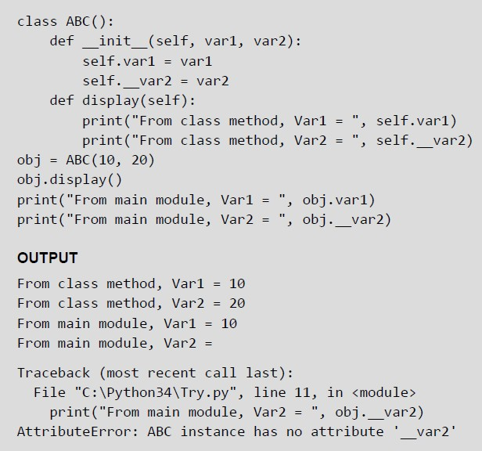
Public & Private Members
Dr.K.Sandeep

Slide 34
The Destructors or del () Method
Destructors are called when an object gets destroyed.
In Python, destructors are not needed as much needed in C++ because Python has a garbage collector that handles memory management automatically.
The del () method is a known as a destructor method in Python.
It is called when all references to the object have been deleted i.e when an object is garbage collected.

Slide 35
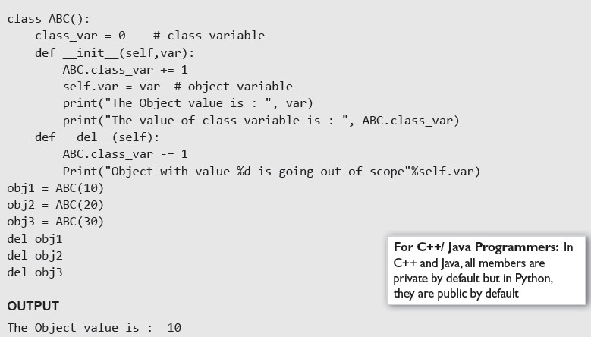
The Destructors or del () Method
Dr.K.Sandeep

Slide 36
Other Special Methods
repr (): __ The repr () function is a built-in function with syntax repr(object). It returns a string representation of an object. The function works on any object, not just class instances.
• cmp (): The cmp () function is called to compare two class objects.
• len__(): The len__() function is a built-in function that has the syntax, len(object). It returns the length of an object.

Slide 37
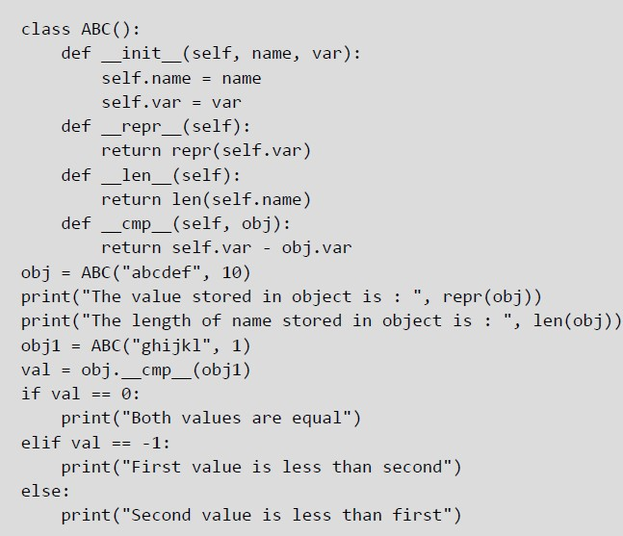
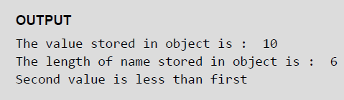
Other Special Methods

Slide 38
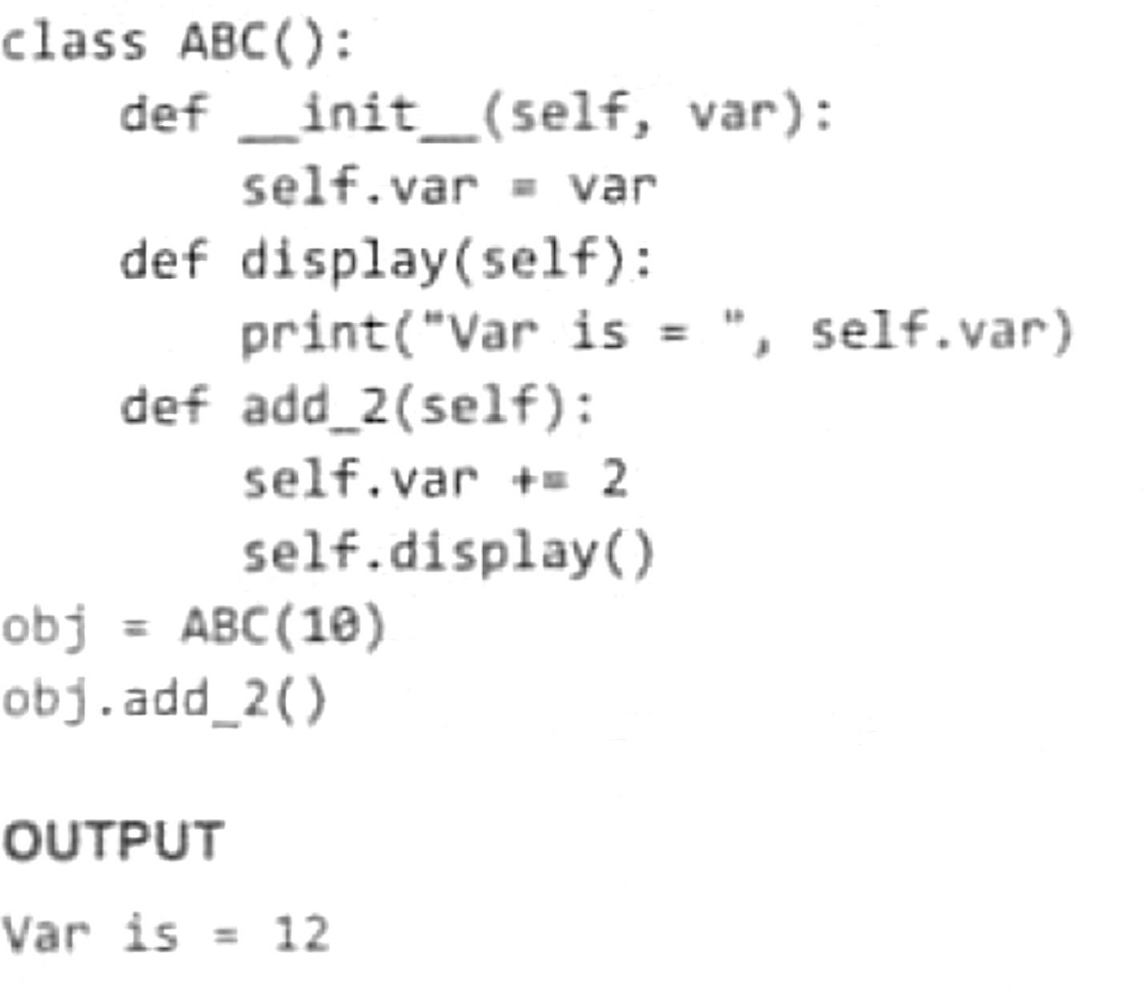
Calling Class Method from another Class Method
Dr.K.Sandeep

Slide 39
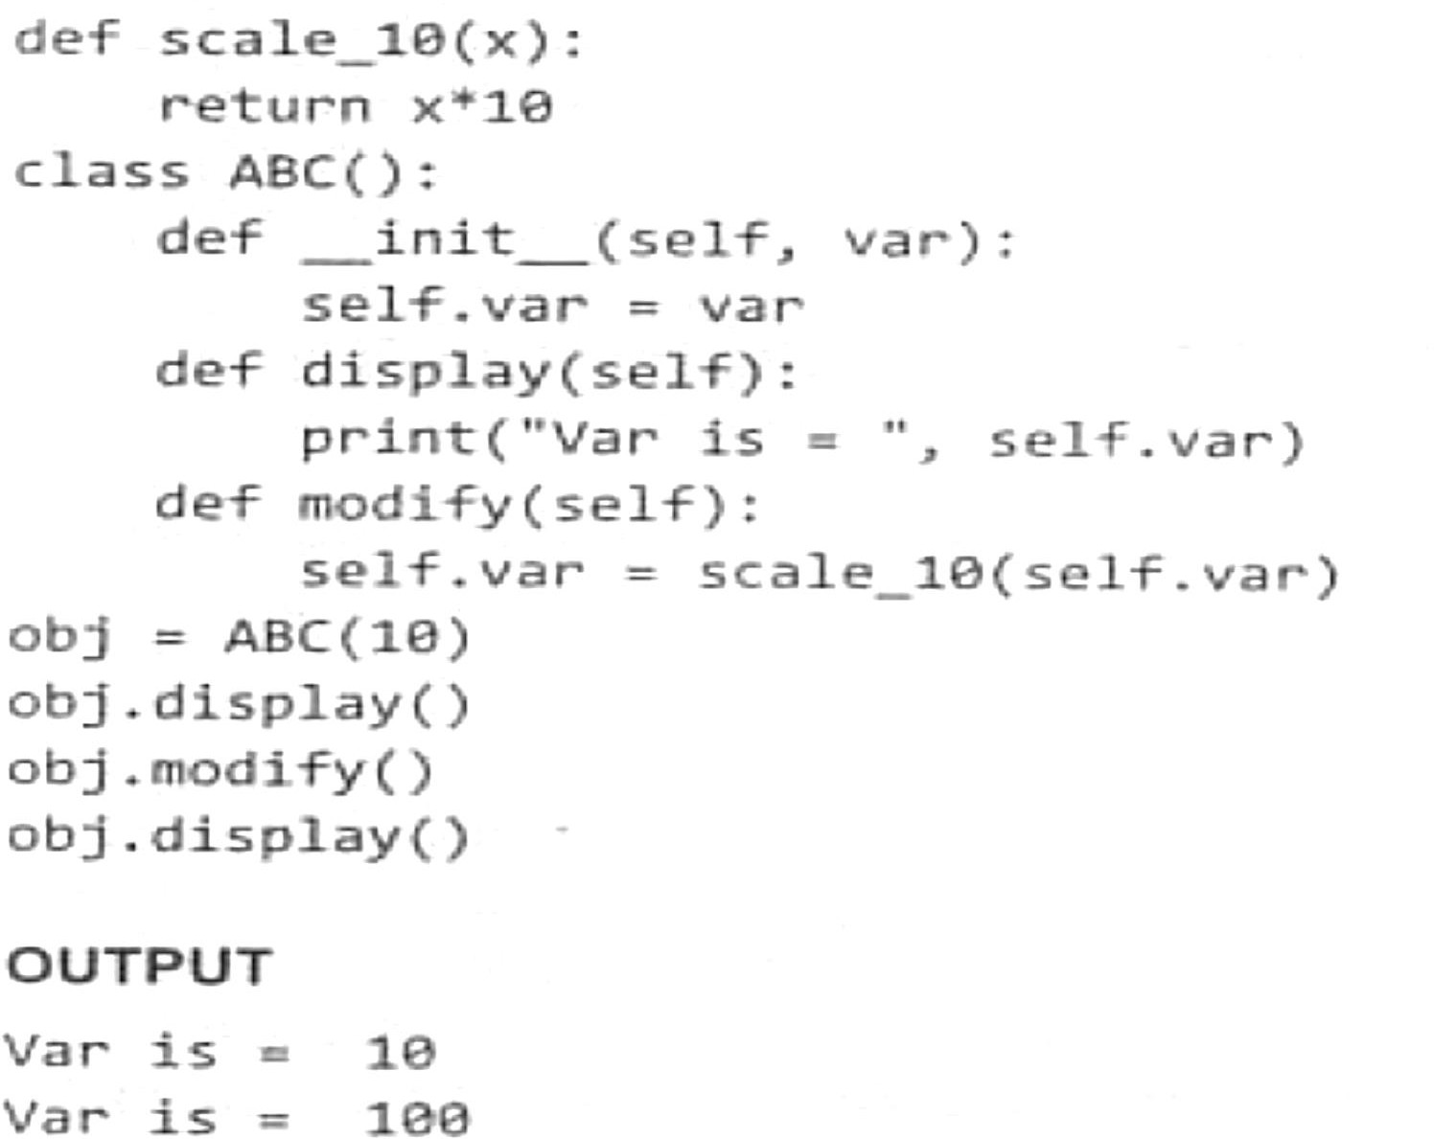
Class Method calls a function defined in global
Dr.K.Sandeep

Slide 40
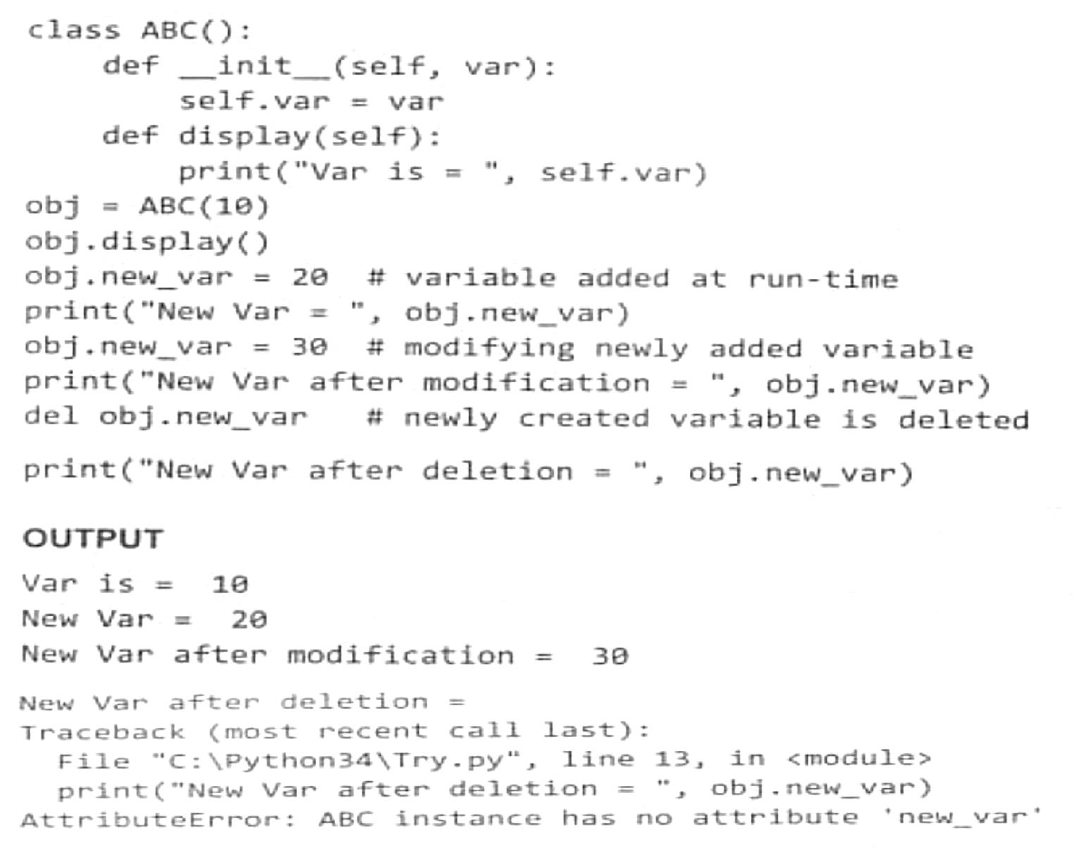
Add Variables to class at Run-time
Dr.K.Sandeep

Slide 41
Built-in Functions To Check, Get, Set And Delete Class Attributes
hasattr(obj,name): The function is used to check an object possess the attribute or not.
getattr(obj, name[, default]): The function is used to access or get the attribute of object. Since getattr() is a built-in function and not a method of the class, it is not called using the dot operator.
Rather, it takes the object as its first parameter. The second parameter is the name of the variable as a string, and the optional third parameter is the default value to be returned if the attribute does not exist.
If the attribute name does not exist in the object's namespace and the default value is also not specified, then an exception will be raised. Note that, getattr(obj, 'var') is same as writing obj.var. However, you should always try to use the latter variant.

Slide 42
Built-in Functions To Check, Get, Set And Delete Class Attributes
setattr(obj,name,value): The function is used to s et an attribute of the object.
If attribute does not exist, then it would be created. The first parameter of the setattr() function is the object, the second parameter is the name of the attribute and the third is the new value for the specified attribute.
delattr(obj, name): The function deletes an attribute. Once deleted, the variable is no longer a class or object attribute.

Slide 43
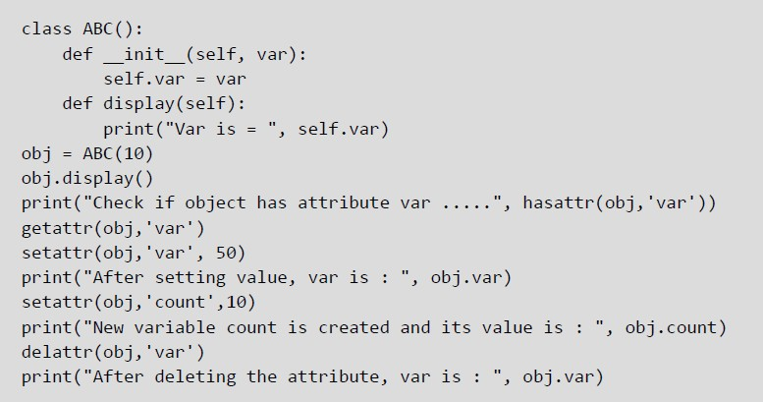
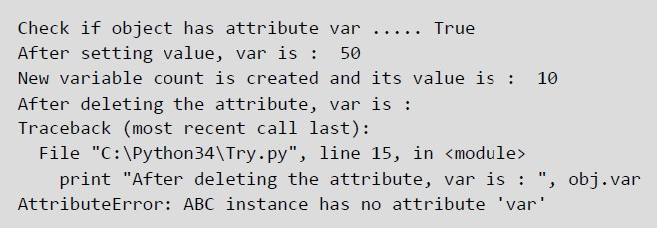
Built-in Functions To Check, Get, Set And Delete
Class Attributes

Slide 44
Inheritance
The technique of creating a new class from an existing class is called
inheritance.
The old or existing class is called the base class and the new class is known as the derived class or sub-class.
The derived classes are created by first inheriting the data and methods of the base class and then adding new specialized data and functions in it.
In this process of inheritance, the base class remains unchanged. The concept of inheritance is used to implement the is-a relationship.
For example, teacher IS-A person, student IS-A person; while both teacher and student are a person in the first place, both also have some distinguishing features.

Slide 45
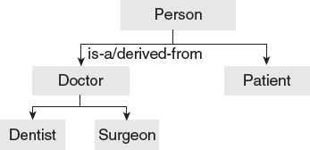
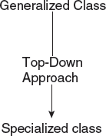
Inheritance
Inheritance which follows a top down approach to problem solving.
In top-down approach, generalized classes are designed first and then specialized classes are derived by inheriting/extending the generalized classes.

Slide 46
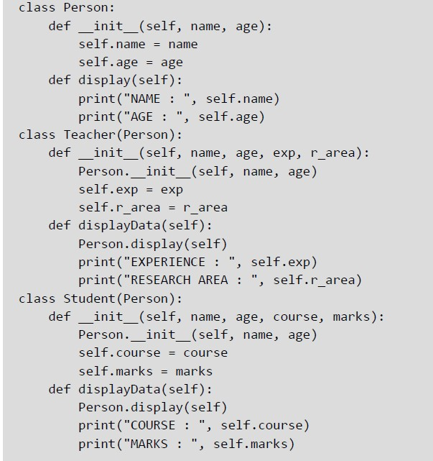
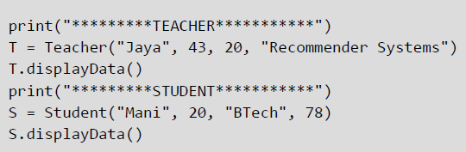
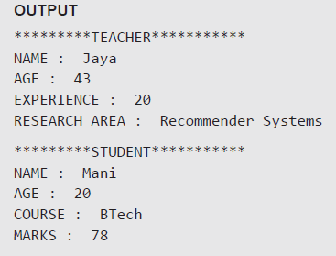
Inheritance Example
Dr.K.
Sandeep

Slide 47
super() Method
When a class inherits some or all of the behaviors from another class is known as Inheritance.
In such a case, the inherited class is the subclass and the latter class is the parent class.
In an inherited subclass, a parent class can be referred to with the use of the super() function.
The super function returns a temporary object of the superclass that allows access to all of its methods to its child class.

Slide 48
Inheritance
class quadriLateral:
def init (self, a, b, c, d): self.side1=a self.side2=b self.side3=c self.side4=d
def perimeter(self):
p=self.side1 + self.side2 + self.side3 + self.side4
print("perimeter=",p)
class rectangle(quadriLateral): def init (self, a, b):
super(). init (a, b, a, b)
>>>q1=quadriLateral(7,5,6,4)
>>>q1.perimeter()
>>> r1=rectangle(10, 20)
>>> r1.perimeter()

Slide 49
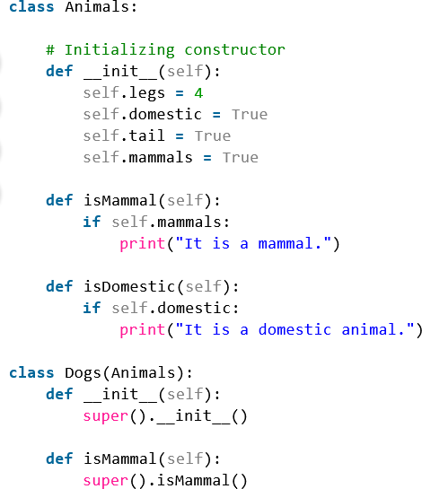
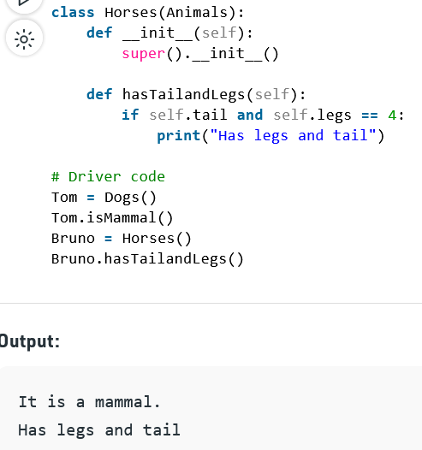
Inheritance Example

Slide 50
Polymorphism and Method Overriding
Polymorphism refers to having several different forms. It is one of the key features of OOP.
It enables the programmers to assign a different meaning or usage to a variable, function, or an object in different contexts.
While inheritance is related to classes and their hierarchy, polymorphism, on the other hand, is related to methods.
In Python, method overriding is one way of implementing polymorphism.

Slide 51
Example 1: Polymorphism in addition operator
num1 = 1
num2 = 2 print(num1+num2)
Hence, the above program outputs 3
str1 = "Python"
str2 = "Programming" print(str1+" "+str2)
Hence, the above program outputs Python Programming

Slide 52
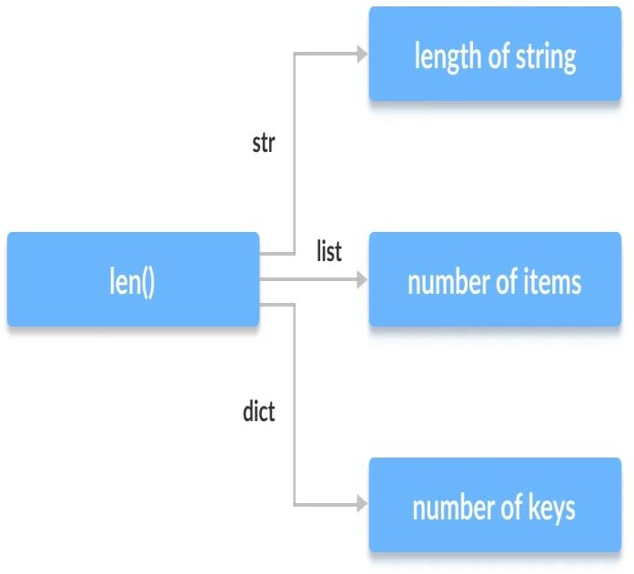
Function Polymorphism in Python Example 2: Polymorphic len function
There are some functions in Python which are compatible to run with multiple data types.
One such function is the len() function. It can run with many data types in Python
print(len("Programiz")) print(len(["Python", "Java", "C"]))
print(len({"Name": "John", "Address": "Nepal"}))
Hence, the above program outputs 9 3 2

Slide 53
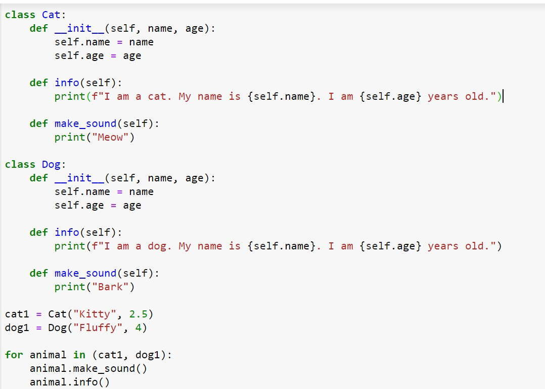
Example 3: Polymorphism in Class Methods
Dr.K.Sandeep
However, notice that we
have not created a
or
common superclass linked the
classes
together in any way
we can pack
these two
different objects into a tuple and iterate through it using a common animal variable. It is possible due to polymorphism.

Slide 54
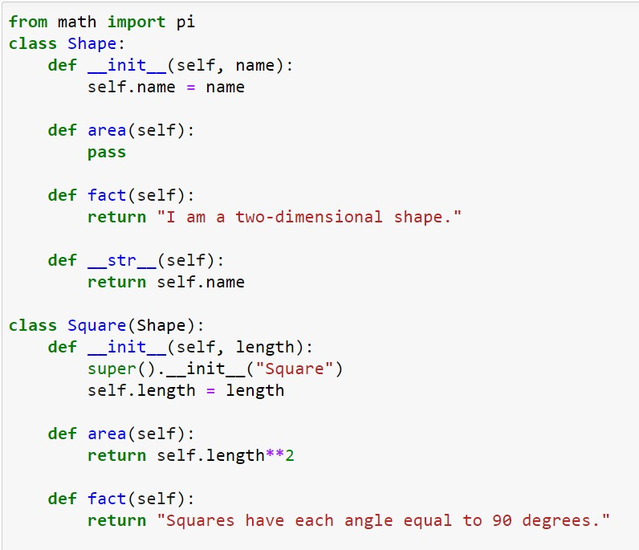
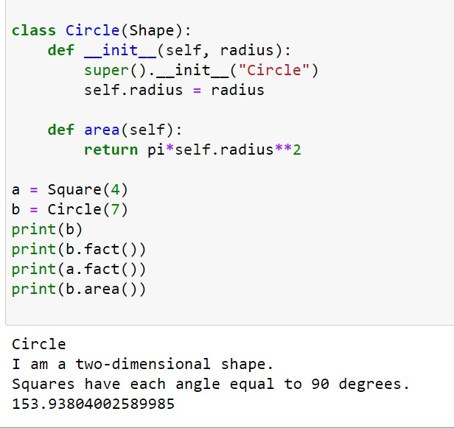
Example 4: Method Overriding
Dr.K.
ndeep

Slide 55
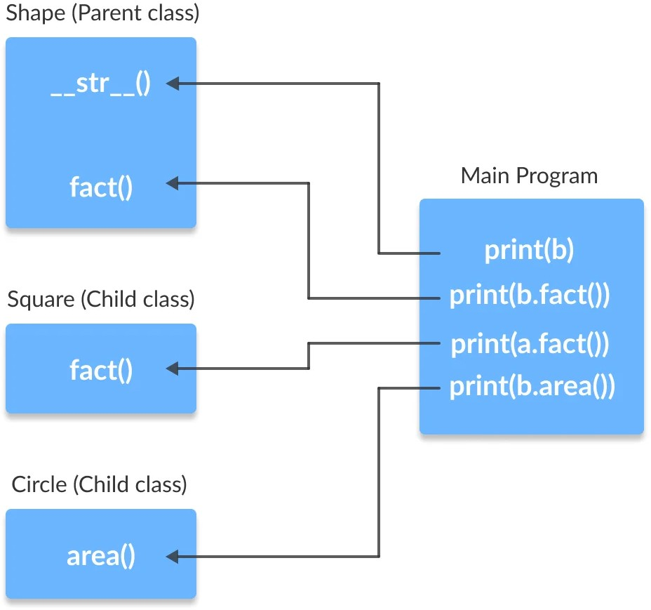
Example 4: Method Overriding
Here, we can see that the method
str (), which have not been overridden in the child classes, are used from the parent class.
Due to polymorphism, the Python interpreter automatically recognizes that the fact() method for object a(Square class) is overridden. So, it uses the one defined in the child class.
On the other hand, since the fact() method for object b isn't overridden, it is used from the Parent Shape class.

Slide 56
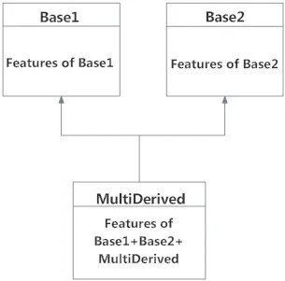
Multiple Inheritance
When a derived class inherits features from more than one base class, it is called multiple inheritance.
The derived class has all the features of both the base classes and in addition to them can have additional new features.
class Base1:
statement block class Base2:
statement block
class MultiDerived (Base1, Base2): statement block

Slide 57
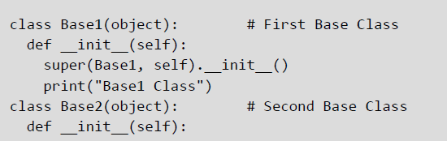
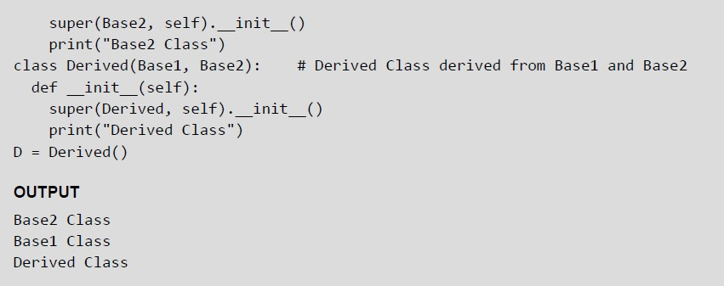
Multiple Inheritance

Slide 58
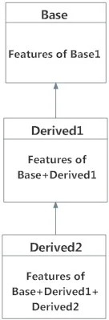
Multi-Level Inheritance
The technique of deriving a class from an already derived class is called multi - level inheritance.
The syntax for multi-level inheritance can be given as, class Base:
pass
class Derived1(Base): pass
class Derived2(Derived1): Pass

Slide 59
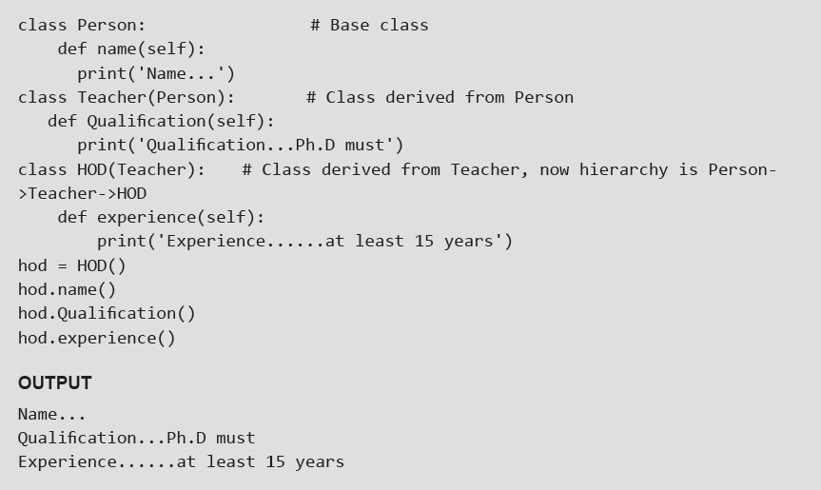
Multi-Level Inheritance
Dr.K.Sandeep

Slide 60
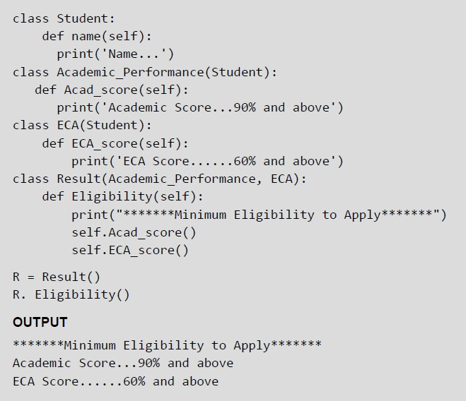
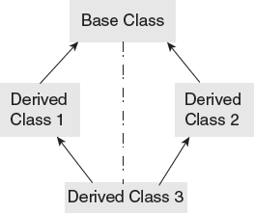
Multi-path Inheritance
Deriving a class from other derived classes that are in turn derived from the same base class is called multi-path inheritance.

Slide 61
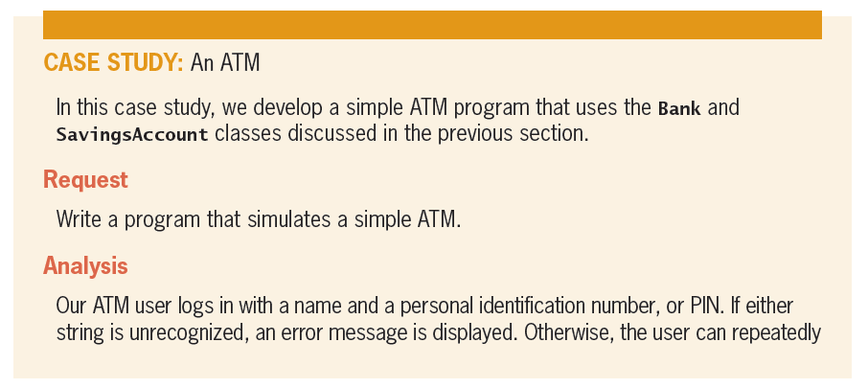
CASE STUDY: An ATM

Slide 62
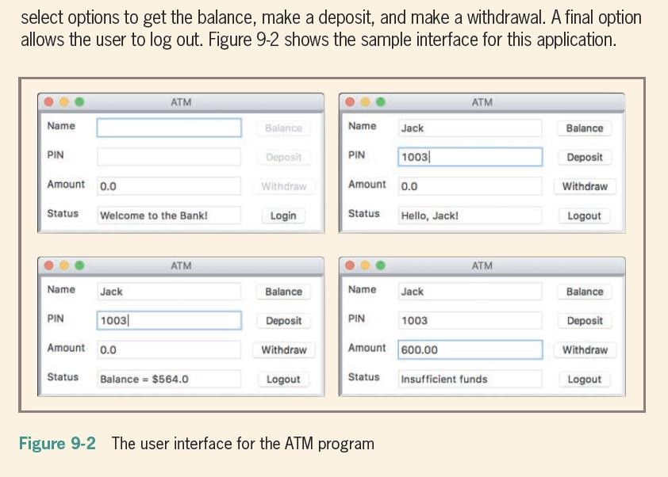
Dr.K.Sandeep

Slide 63
Object-oriented Programming
Vs Procedural Programming
Object-oriented Programming | Procedural Programming
Object-oriented programming is the problem-solving approach and used where computation is done by using objects. | Procedural programming uses a list of instructions to do computation step by step.
It makes the development and maintenance easier. | In procedural programming, It is not easy to maintain the codes when the project becomes lengthy.
It simulates the real-world entity. So real-world problems can be easily solved through oops. | It doesn't simulate the real world. It works on step- by-step instructions divided into small parts called functions.
It provides data hiding. So it is more secure than procedural languages. You cannot access private data from anywhere. | Procedural language doesn't provide any proper way for data binding, so it is less secure.
Example of object-oriented programming languages is C++, Java, .Net, Python, C#, etc. | Example of procedural languages are: C, Fortran, Pascal, VB etc.

Slide 64



